Slide 1

Software Release Planning for Agile Project Management
Group43
Team Members:
Aditya Sai Kolluru(A20516766.)
Divinesh Chalicham(A20511955)
R Prem Swaroopa Nanda(A20547712)

Slide 2

Content
Agile Release Planning
The Need for Release Planning
Key Components of Release Planning
Release Planning Process
Challenges in Release Planning
Monitoring Progress
Benefits of Agile Release Planning
Case Study
Conclusion

Slide 3
Introduction to Agile Release Planning
Prioritizing Features:
Identifying and ranking features based on business value and stakeholder needs.
Creating a Product Backlog:
Compiling a list of user stories and tasks that make up the desired product features.
Sprint Planning:
Allocating user stories to specific development sprints, each typically lasting 1-4 weeks.
Defining Release Goals:
Establishing clear objectives and outcomes for each release cycle to guide development.
Continuous Monitoring and Adaptation:
Regularly reviewing progress, adjusting plans based on feedback, and ensuring alignment with changing priorities.

Slide 4
The Need for Release Planning
Dynamic Business Environment:
Adapting to rapidly changing market conditions and customer expectations.
Risk Mitigation:
Minimizing project risks by breaking down work into manageable iterations.
Stakeholder Collaboration:
Ensuring alignment with stakeholder expectations and obtaining continuous feedback.
Value Delivery:
Focusing on delivering high-value features early and frequently to end-users.
Resource Optimization:
Efficiently allocating resources by planning and prioritizing work based on business value.

Slide 5
Key Components of Release Planning
Product Backlog:
The product backlog is a dynamic, prioritized list of features, enhancements, and fixes that need to be addressed in the product. It's maintained and regularly refined by the Product Owner.
User Stories:
User stories are short, simple descriptions of a feature told from the perspective of the person who desires the new capability, usually a user or customer. They help to break down features into manageable and understandable parts.
Release Goals and Objectives:
Clearly defined goals and objectives for the release set the overarching direction for the development team. These goals should align with business objectives and customer needs.
Sprint Planning:
Sprint planning involves breaking down the items from the product backlog into tasks that can be accomplished within a short time frame, typically a sprint (usually 2-4 weeks). The team decides what they can commit to delivering during the sprint.
Capacity Planning:
Understanding the team's capacity to take on work is crucial. This involves considering team member availability, skills, and any potential constraints.

Slide 6
Contd.
Dependencies and Constraints:
Identifying and understanding dependencies between tasks or features is crucial to avoid bottlenecks. Constraints, such as resource limitations, should also be taken into account during release planning.
Definition of Done (DoD):
The Definition of Done is a checklist of criteria that must be fulfilled for a user story or task to be considered complete. It ensures a shared understanding of what "done" means in the context of the project.
Risk Assessment:
Identifying and assessing potential risks that could impact the release is an important part of planning. This allows for proactive mitigation strategies to be put in place.
Feedback Mechanisms:
Building in mechanisms for continuous feedback from stakeholders and end-users ensures that the product remains aligned with expectations. Regularly reassessing priorities based on feedback is a key agile principle.
Release Review and Retrospective:
At the end of each release, conducting a review to assess what was delivered against what was planned, and a retrospective to reflect on the process and identify areas for improvement, ensures a continuous learning and improvement cycle.

Slide 7

Release Planning Process
Step-by-Step Guide
Conducting a release planning meeting
Establishing release goals
Creating a release roadmap
Release Roadmap
Visualizing the Plan
Gantt charts or timeline diagrams
Milestones and key deliverables
Dependencies and constraints

Slide 8
Challenges in Release Planning
Uncertain Requirements:
User needs and market conditions can change rapidly, leading to uncertainty in requirements. Adapting to these changes while maintaining the release schedule can be challenging.
Resource Constraints:
Limited availability of team members or specific skill sets can hinder the smooth execution of the release plan. Cross-training and capacity planning are essential to address resource constraints.
Changing Priorities:
Stakeholders may alter their priorities based on emerging market trends or competitive pressures. Effectively managing changing priorities without disrupting ongoing work can be a challenge.
Dependencies and Coordination:
Projects often involve interdependent tasks or features. Coordinating these dependencies and ensuring that teams are synchronized in their efforts can be complex, especially in larger organizations.
Balancing Speed and Quality:
The desire to deliver quickly may sometimes conflict with the need to maintain high-quality standards. Striking the right balance between speed and quality is an ongoing challenge in Agile Release Planning.

Slide 9
Monitoring Progress
Tracking and Adaptation
Burndown charts
Regular reviews and retrospectives
Adjusting the plan based on feedback

Slide 10
Benefits of Agile Release Planning
Faster Time-to-Market:
Agile release planning allows for the delivery of smaller increments of value in short iterations (sprints), enabling quicker releases and faster responses to changing market demands.
Adaptability to Change:
Agile methodologies embrace change and uncertainty. Release plans are continuously reviewed and adapted, allowing teams to respond quickly to shifting priorities, new requirements, or unforeseen challenges.
Improved Stakeholder Collaboration:
Involving stakeholders, including customers, throughout the release planning process fosters better collaboration. Regular feedback loops ensure that the delivered product aligns with customer expectations and business needs.
Enhanced Visibility and Transparency:
Agile release planning provides a clear and transparent view of project progress. Tools like burndown charts and regular reviews offer visibility into team performance, allowing for early identification and resolution of potential issues.
Incremental Value Delivery:
By breaking down features into smaller, manageable user stories, Agile release planning enables the incremental delivery of value. This ensures that valuable features are delivered sooner, providing tangible benefits to end-users and stakeholders with each release.

Slide 11
Methodologies
Iteration Based Planning
Iteration-based Planning is a collaborative, iterative method dividing work into two to four-month release phases. Stakeholders meet at planning events to prioritize and allocate features to development teams, emphasizing constant input and flexibility. Transparency and collaboration are key throughout the development lifecycle, fostering adaptability and stakeholder involvement.
Continuous Release Planning
Continuous Release Planning (CRP) is a dynamic methodology driven by weekly steering committee decisions on five features. Starting with high-level ideas, it evolves through detailed concept investigations. Adapting to changing priorities, CRP ensures a steady feature flow into releases, maintaining consistency and flexibility in development over an extended duration..
Incremental Release Planning(IRP)
Incremental Release Planning (IRP) in Scrum involves breaking down release planning into short, focused sessions, each dedicated to planning one release. This method ensures more accurate estimates. Conducting frequent, brief sessions allows for informed, considered estimates, resulting in a complete release plan that the team believes in.

Slide 12

Case Study – F Secure
A longitudinal strategy was used in the F-Secure case study on the Release Iteration Planning method to gain full insights. The authors watched five planning events, documented their observations in a case journal, and conducted surveys with participants, getting 33 and 26 replies, respectively, for the first and second events. Three additional planning events, retrospectives, and post-project interviews were also examined for a more thorough study. The data collection process included voice recordings, notes, and field observations, resulting in a full and comprehensive dataset. This method provided for a thorough knowledge of the application and implications of the Release Iteration Planning method within the context of F-Secure.

Slide 13
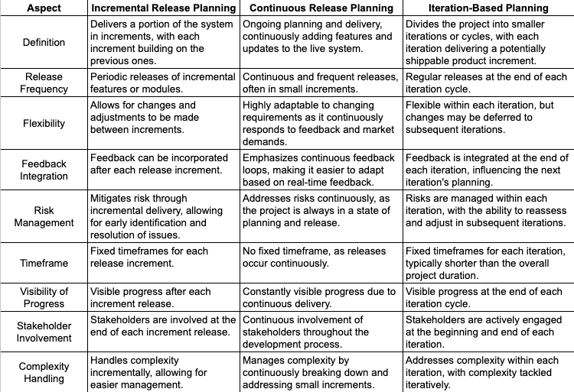
Analysis

Slide 14

Conclusion
Agile Release Planning is like making a flexible roadmap for building software. It's about working closely with the whole team and customers, planning in short steps, and delivering important parts of the project regularly. This helps adapt to changes quickly, make improvements along the way, and make sure the most valuable features reach users faster. It's like a team adventure, where everyone plans, adjusts, and works together to create the best product.

Slide 15

References
https://waynedgrant.wordpress.com/2012/11/25/incremental-release-planning/
https://www.researchgate.net/publication/292139320_Case_studies_on_release_planning_in_agile_development_organizations.
Per Runeson and Markus Borg. Proceedings of the 2011 26th IEEE/ACM International Conference on Automated Software Engineering.
Per Runeson, Richard Berntsson Svensson, and David Höök. Proceedings of the First International Symposium on Empirical Software Engineering and Measurement, 2007.

Slide 16
THANK YOU

